Slide 1


Assembly Validation

Slide 2
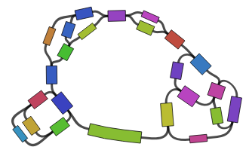
Assembly graphs
Assemblies are written in fasta/q format.
Loses connection information between the contigs/scaffolds.
Some assemblers also write GFA format (Graphical Fragment Assembly)
Keeps the relationship between contigs.
Visualized using Bandage

Slide 3
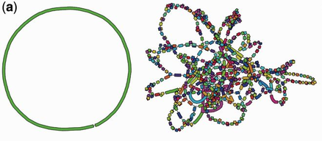
Assembly graphs
Ideal bacterial assembly graph
Poor assembly

Slide 4
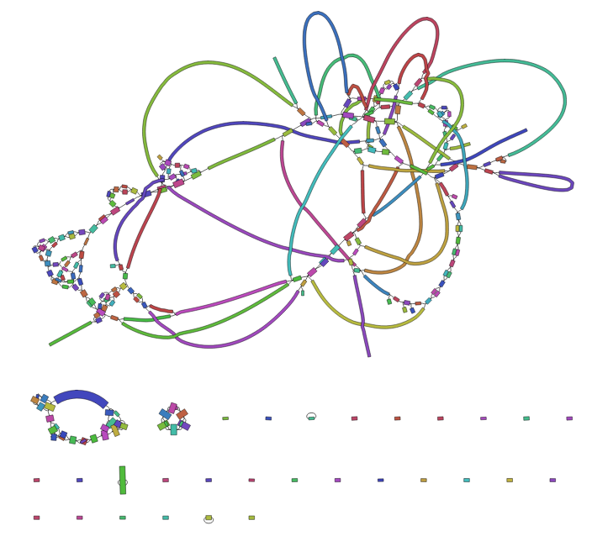
Assembly graphs
Average assembly

Slide 5
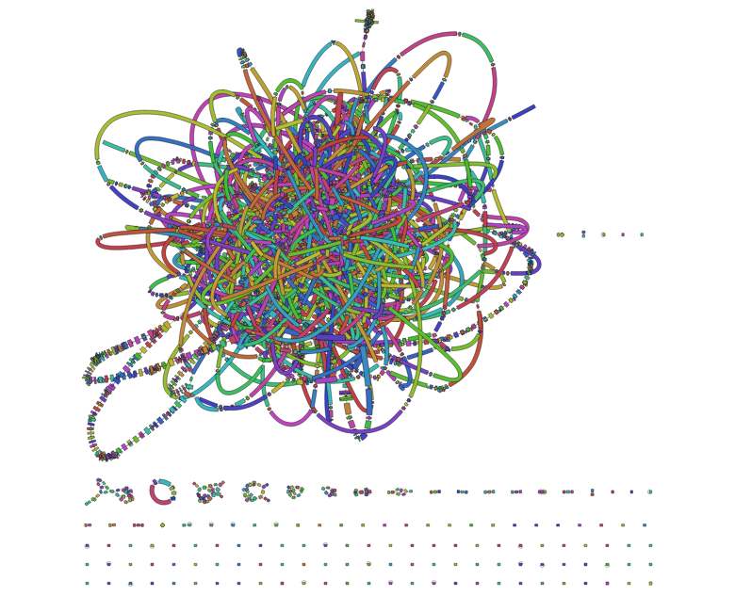
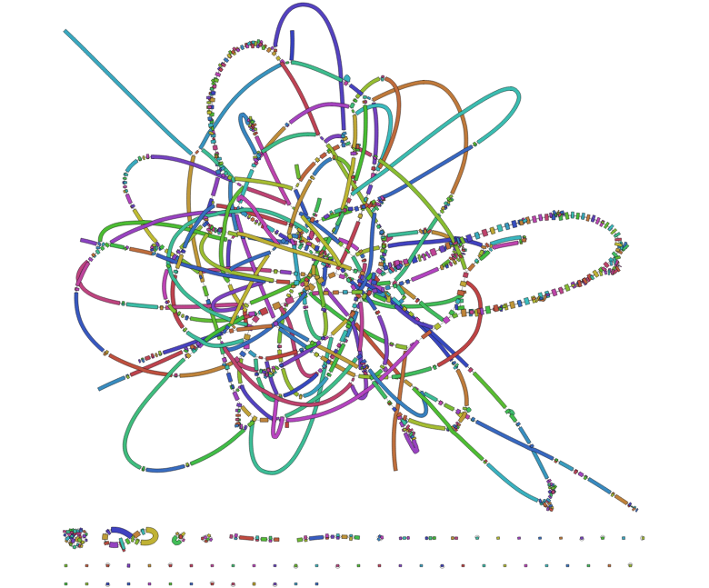
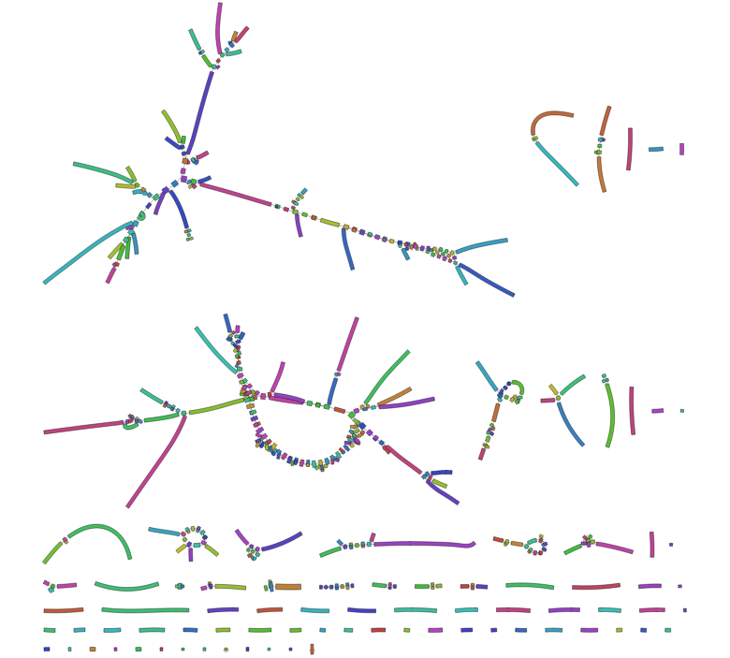
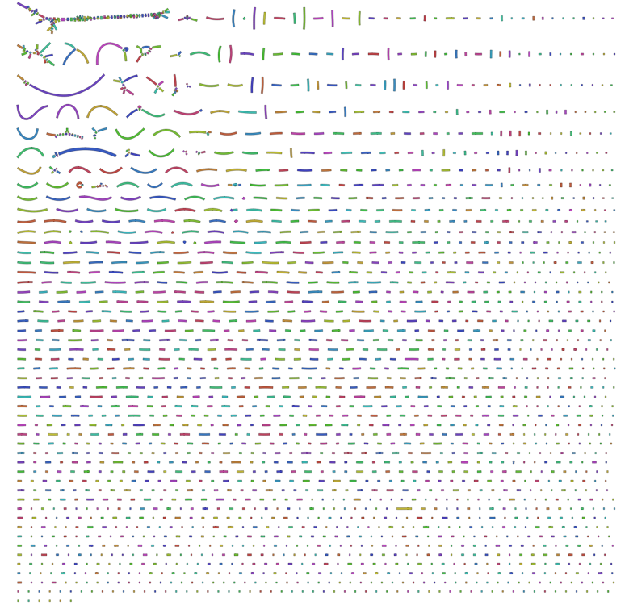
Assembly graphs
Evaluate k-mer choice
K=51
K=61
K=81
K=91
R. Wick: Effect of k-mer size.

Slide 6
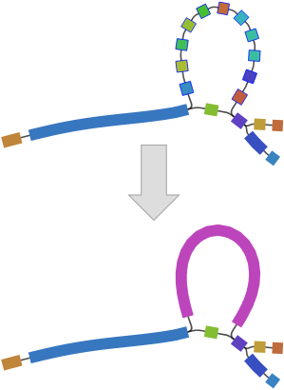
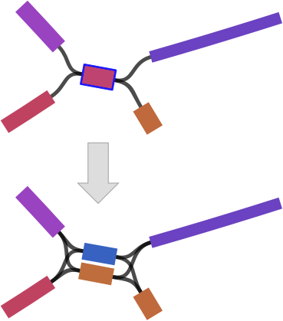
Assembly graphs
Manipulate graphs

Slide 7
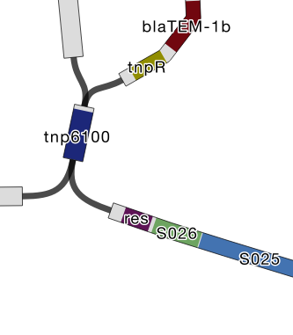
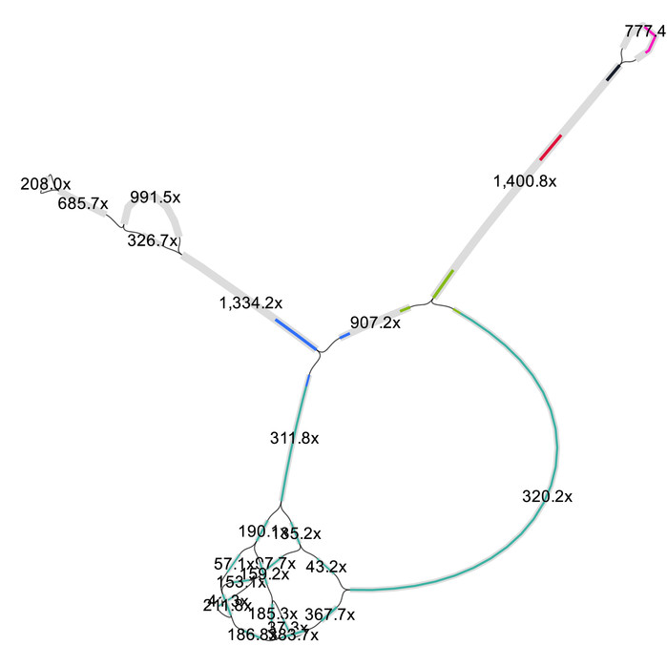
Assembly graphs
Graph labeling
Contig coverage
Blast results

Slide 8
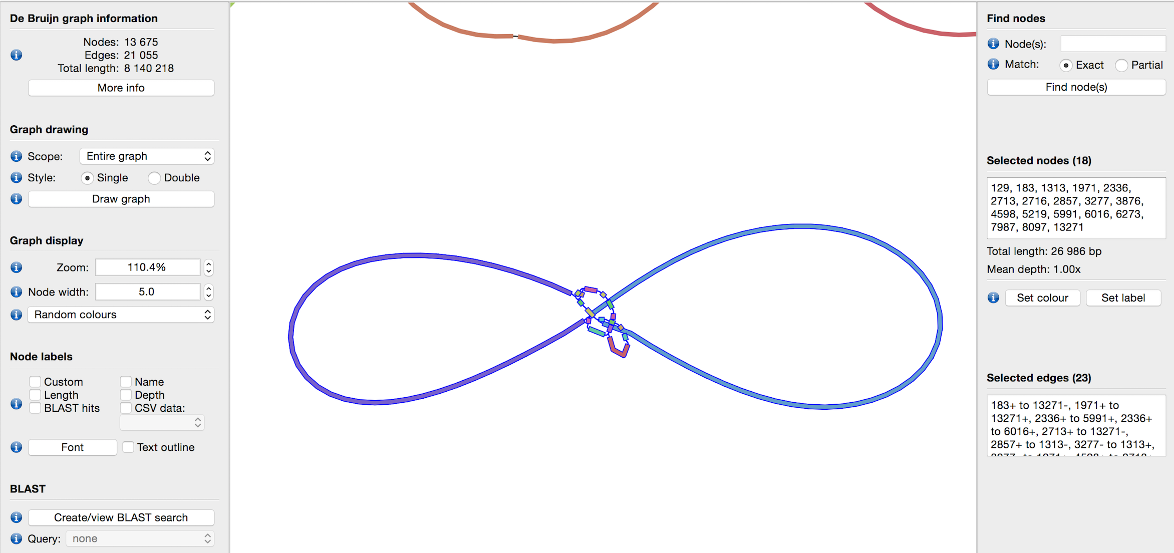
Assembly graphs
COI gene blast match to this contig

Slide 9
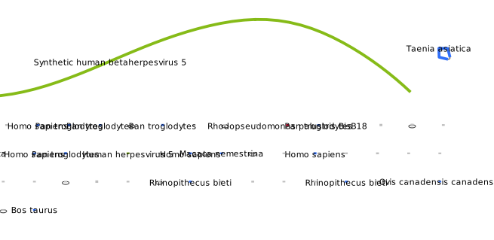
Assembly graphs
What do you see?
Virus sample isolated from human
Reads were filtered against human ref

Slide 10
Assembly graphs
What do you see?
Virus sample isolated from human
Reads were filtered against human ref
PhiX spike-in
Human contamination

Slide 11
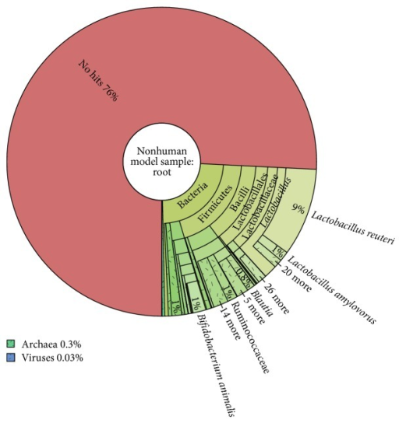
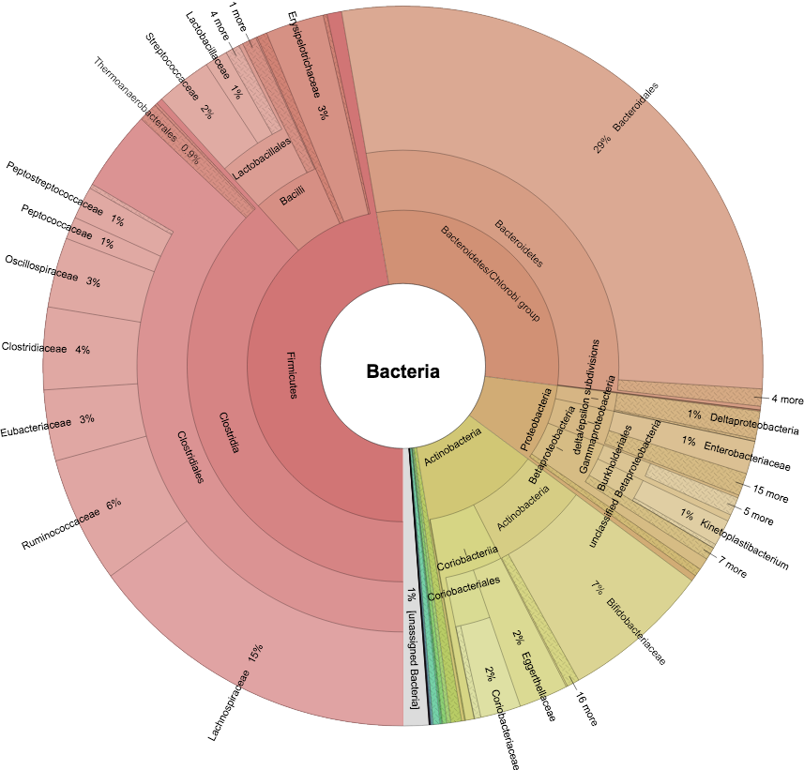
Contamination
Kraken / Blast / Kaiju taxonomic classification

Slide 12
Contamination assessment
Blobtools GC vs Coverage Taxonomically annotated

Slide 13
Contamination assessment
Blobtools
False positive matches to hypothetical proteins
Sign of bacterial contamination

Slide 14
Contamination assessment
Blobtools
What’s your interpretation?
Moss sample.
Haploid cell picked for one individual.

Slide 15
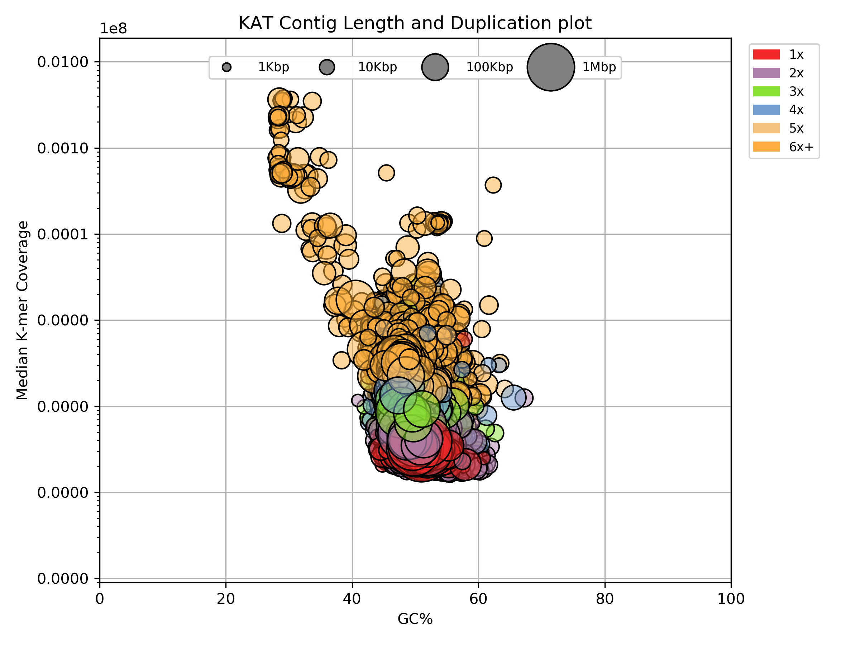
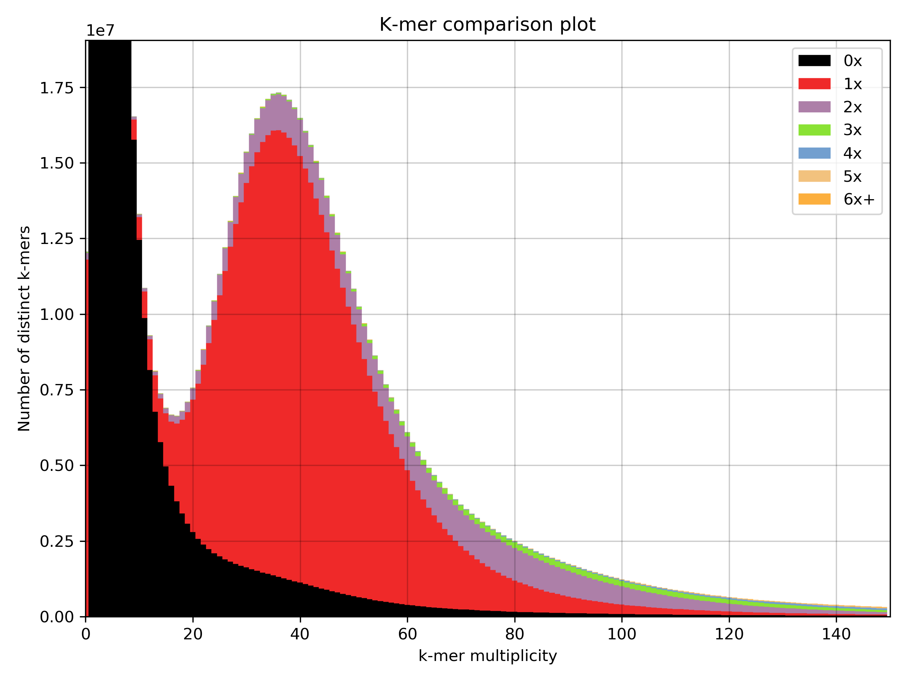
Contamination assessment
Kat cold
Median k-mer abundance in assembly contigs.

Slide 16
Contamination assessment
Kat cold
Repeats:
Small size
High coverage
Median k-mer abundance in assembly contigs.
Contamination:
Multiple groups of gradients

Slide 17
Summary
Contamination detection is tricky.
GC vs Coverage plots are useful overviews.
If you have access to the assembly graph, use it.
Be conservative when filtering
Remove spike-in / control sequences

